Slide 1
TNE20002/TNE70003
Topic 4 EIGRP V1.1

Slide 2
EIGRP
Enhanced
Interior Gateway
Routing
Protocol
Notes:
4.1.1.1 Features of EIGRP

Slide 3
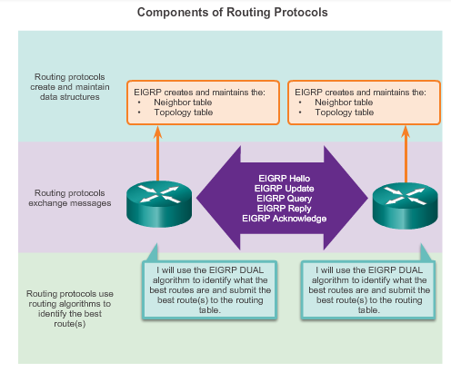
Components of Routing Protocol EIGRP
Data Structures
Routing table
Routing table
Messages
RTP
Algorithm
DUAL
Notes:
3.1.1.2 Purpose of Dynamic Routing Protocols (cont.)

Slide 4
Data Structures: Three Tables
EIGRP Neighbor Table
Next-Hop Router | Interface
List of directly connected routers with
which a router has an adjacency
EIGRP Topology Table
Destination | FD via Each Neighbor
List of all routes learned from each
neighbor
EIGRP Routing Table
Destination | Least Cost Route FD
List of all least cost routes from Topology Table

Slide 5
Messages
Reliable Transport Protocol (RTP)
used to deliver
Message Packets
to
Neighbors
Notes:
4.1.1.1 Features of EIGRP

Slide 6
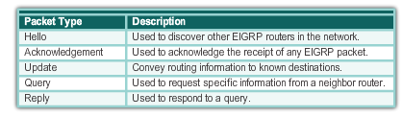
EIGRP Packet Types - Messages
Notes:
4.1.2.1 EIGRP Packet Types

Slide 7
EIGRP - Hello
Used to discover EIGRP neighbors.
Used to form and maintain EIGRP neighbor adjacencies.
Sent as IPv4 or IPv6 multicasts.
IPv4 layer 3 multicast address 224.0.0.10
IPv6 layer 3 multicast address FF02::A.
Hello Interval – default, send Hello every 5 seconds
Hold timer
by default set to three times the Hello interval.
If have not received Hello from neighbor within 15 secs, declare neighbor unreachable.
Unreliable Delivery - requires no response from recipient
Notes:
4.1.2.2 EIGRP Hello Packets

Slide 8
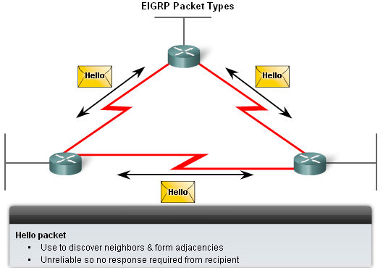
EIGRP – Hello
Used to discover and form adjacencies with neighbors
show ip eigrp neighbors – verifies adjacency has been established

Slide 9
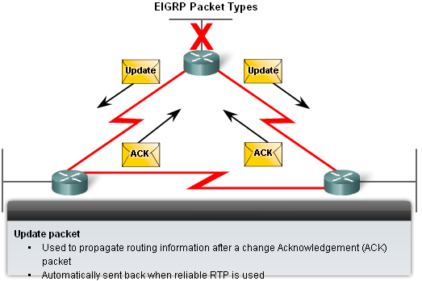
EIGRP – Update
Update
Used to propagate routing information
Reliable Delivery
ACK packets
Used to acknowledge receipt of update
Update Packet
Used to propagate routing information, after a change
Acknowledged (ACK) by receiving router, reliable delivery

Slide 10
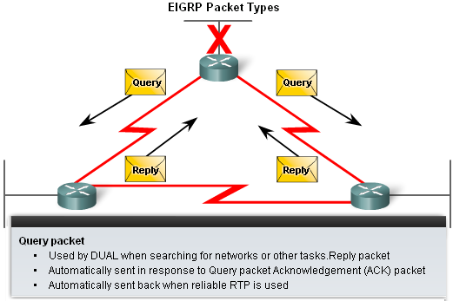
EIGRP – Query
Query & Reply packets
Used to request alternate path information from neighbors
Query Packet
Used by DUAL when searching for networks
Reply packet sent in response to Query

Slide 11
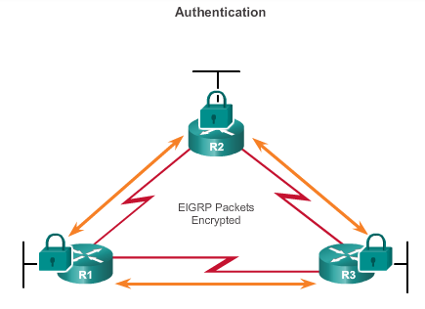
Authentication of Updates
EIGRP can be configured to authenticate routing information.
Ensures routers only accept updates from routers that have been configured with the correct authentication information.
Default NO authentication
Notes:
4.1.1.4 Authentication

Slide 12
EIGRP Configuration: ASN, Wildcard
Specifying which subnets should be advertised:
The wildcard specifies a subnet within the network
Wildcard is inverse of subnet mask
Configuration:
router eigrp 1 <- Autonomous System Number (ASN)
network 145.60.0.0 0.0.0.127 ← Wildcard inverse of mask 255.255.255.128
network 145.60.0.128 0.0.0.63
network 145.60.0.224 0.0.0.15
network 145.60.0.240 0.0.0.3

Slide 13
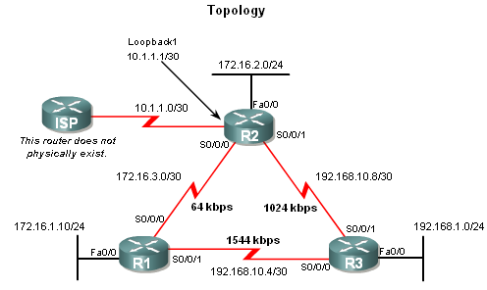
EIGRP – Wildcards
Mask Wildcard
255.255.255.252 -> 0.0.0.3
Mask Wildcard
255.255.255.0 -> 0.0.0.255

Slide 14
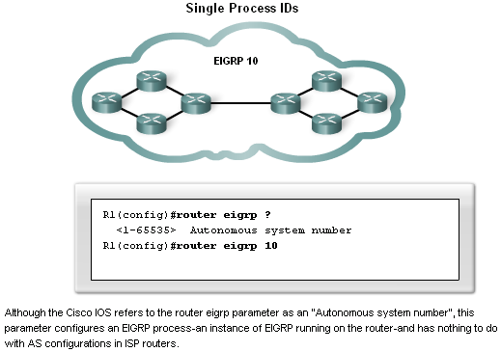
EIGRP – Autonomous System Number
Two Roles
Acts as a Process ID representing an instance of the routing protocol running on a router
Acts as Group ID - Only routers using the same AS number can exchange updates with each other

Slide 15
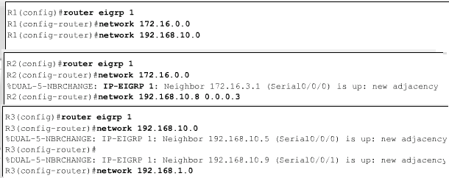
EIGRP – Wildcard, ASN
Used to specify a subnet or range of subnet network addresses
The wildcard mask is the inverse of the subnet mask
Swap all ‘0’ bits for ‘1’ and ‘1’ bits for ‘0’
You can type in subnet mask, router will change to wildcard for you
R1,R2 and R3 are in Autonomous System 1
255.255.255.252 -> 0.0.0.3

Slide 16
The
Topology
Table

Slide 17
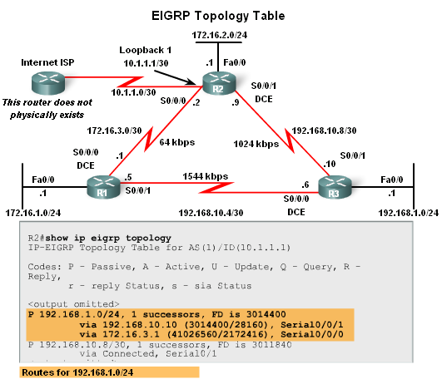
EIGRP Topology Table – R2 to 192.168.1.0
All successor routes
All feasible successor routes
Backup
Least Cost
R2
Successor
(Least Cost)
Feasible Successor
(Backup)

Slide 18
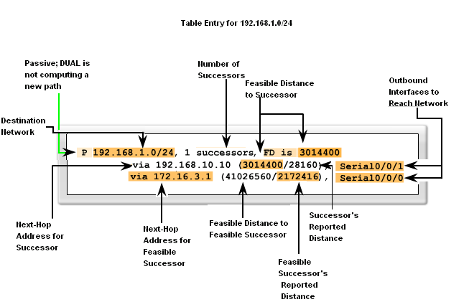
EIGRP Topology Table – R2
R1

Slide 19
How
EIGRP
Handles
a
Link Failure

Slide 20
EIGRP – Link Fails
Link Fails !!
.1
.10

Slide 21
Link Fails - EIGRP Update
A link failure will trigger an update
It is a Partial update, it includes only the route information that has changed – the whole routing table is NOT sent

Slide 22
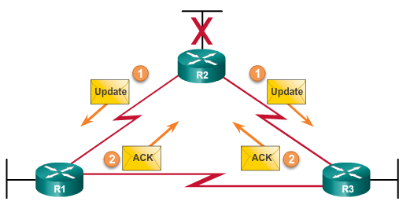
Link Fails: Triggered Update, R2 tells R1 that a Link has failed
S0/0/0
S0/0/1
LINK Fails !! 192.168.10.8/30
192
.2
.9
1024 Kbps
172.16.3.0/30
64 Kbps
.1
.10
192.168.1.0/24
1544 Kbps
192.168.10.4/30
Notes:
4.1.2.3 EIGRP Update & Acknowledgement Packets

Slide 23
EIGRP
R2
Checks
Topology Table
for
Feasible Successor

Slide 24
EIGRP - R2 Checks for Feasible Successor (Backup) to 192.168.1.0
Topology Table
R1

Slide 25
EIGRP
R2
Feasible Successor Found
Place In
Routing Table

Slide 26
EIGRP
OR If no Feasible Successor
R2
Queries
Neighbor
for
New route

Slide 27
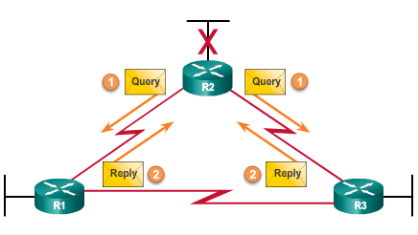
EIGRP – If no Feasible Successor, R2 sends Query to Neighbor R1 for new route
LINK Fails !! 192.168.10.8/30
172.16.3.0/30
192.168.1.0/24
Notes:
4.1.2.4 EIGRP Query and Reply Packets

Slide 28
EIGRP
the
Neighbor Table

Slide 29
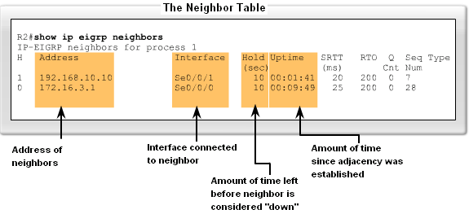
The Neighbor Table – R2 Neighbors
EIGRP routers must establish adjacencies with their neighbors before any updates can be sent or received
First check to see what routers have established communication
show ip eigrp neighbors
To see when last update was received on each interface
show ip protocols

Slide 30
The Neighbor Table – R2 Neighbors
SRTT – Smooth Round Trip Time
The average number of msecs it takes for an EIGRP packet to be sent to this neighbor and for the local router to receive an ACK
RTO – Retransmit Timeout
The amount of time, in ms that a router waits for an ACK before retransmitting a reliable packet to a neighbor
Q – Queue Count
The number of EIGRP packets waiting in the queue to be sent out. If this value is constantly higher than 0, a congestion problem might exist
Seq – The sequence number of the last update, query, or reply EIGRP packet that was received from this neighbor

Slide 31
Redistributing Static Routes
Use command redistribute static:
router eigrp 65
redistribute static
Redistributes static default route on gateway router, to internal routers

Slide 32
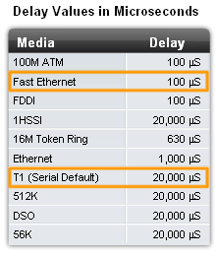
EIGRP Metrics used in determining Least Cost
Bandwidth
Most serial interfaces use a default bandwidth value of 1.544Mbps (T1)
Can be modified using the bandwidth command for each interface
Is a logical value that does not change the link’s physical bandwidth – only the value used in routing protocol calculations
Signal Delay
The measure of time it takes for a packet to traverse a route
Value based on the link type

Slide 33
EIGRP Summary
First released in 1992 as a Cisco proprietary protocol.
2013 basic functionality of EIGRP released to IETF as an open standard.
Authentication
Diffusing Update ALgorithm (DUAL) used to calculate the cost to a destination network
Establishes Neighbor Adjacencies.
Reliable Transport Protocol (RTP) used to provide delivery of EIGRP packets to neighbors.
Partial Updates
Load Balancing - supports Equal and Unequal
Notes:
4.1.1.1 Features of EIGRP

Slide 34
The End
EIGRP Video CertBros
https://www.youtube.com/watch?v=QyymlFWDEgM

